Slide 1

Music Database
Collin Smith, Conor Burrows,
Jake Luedtke, Nicholas Melon

Slide 2
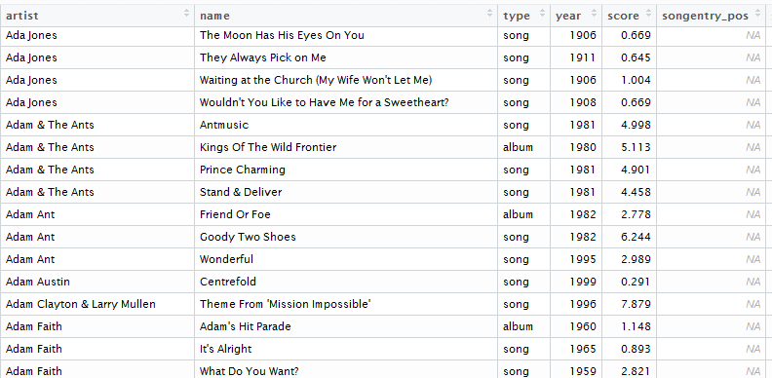
Data Cleaning: Tsort
So clean!
as.character(), filter just the songs, change unknowns to NA

Slide 3

GNAW
Custom wrapper for Gracenote in python
Single search and list functions
Can search 50,000 songs in just under 9 14 hours!
Python dict > JSON array > R data frame
Notes:
In order to fill out metadata for the tsort songs we had to find a way to apply gracenote to our database, so I wrote something I call “GNAW,” the gracenote api wrapper. It can do individual searches for songs and albums as well as aggregate data for a list of songs. This was particularly useful because we had about 53,000 songs to fill out.

Slide 4
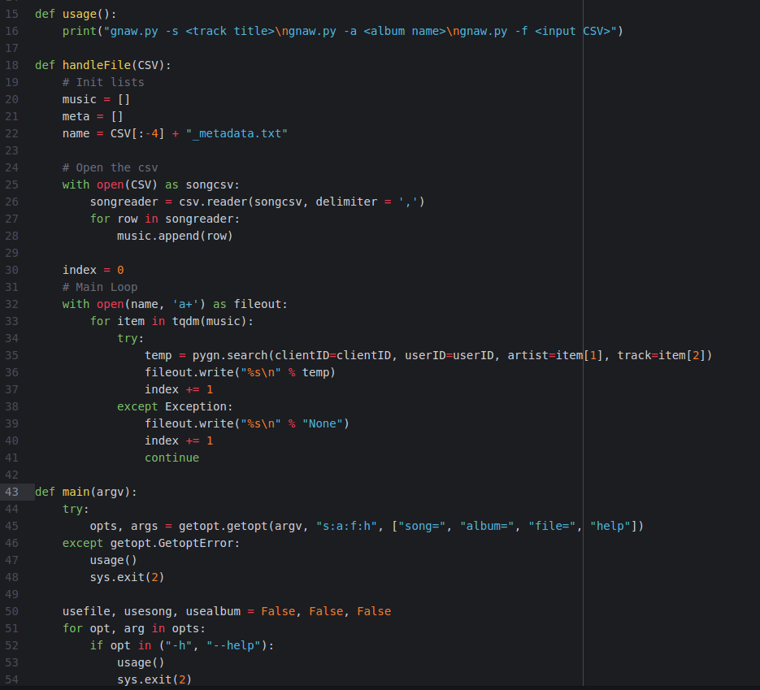
More GNAW
{'track_title': 'Careless Whisper', 'album_artist_name': 'George Michael', 'mood': {'1': {'TEXT': 'Fiery', 'ID': '42953'}, '2': {'TEXT': 'Passionate Rhythm', 'ID': '43016'}}, 'artist_bio_url': '', 'artist_image_url': 'http://akamai-b.cdn.cddbp.net/cds/2.0/image-artist/5461/EA89/A846/676F_medium_front.jpg?cid=1441931071', 'artist_era': {'1': {'TEXT': '1980s', 'ID': '29485'}}, 'album_year': '1998', 'radio_id': '', 'tempo': {'1': {'TEXT': 'Fast Tempo', 'ID': '43078'}, '3': {'TEXT': '150s', 'ID': '34331'}, '2': {'TEXT': 'Fast', 'ID': '34292'}}, 'track_gnid': '5922272-96C3D4A8006763BF491B51AA904C60ED', 'track_number': '3', 'review_url': '', 'album_art_url': 'http://akamai-b.cdn.cddbp.net/cds/2.0/cover/1144/0FB1/A492/82F9_medium_front.jpg?cid=1441931071', 'tracks': [{'track_title': 'Careless Whisper', 'mood': {'1': {'TEXT': 'Fiery', 'ID': '42953'}, '2': {'TEXT': 'Passionate Rhythm', 'ID': '43016'}}, 'tempo': {'1': {'TEXT': 'Fast Tempo', 'ID': '43078'}, '3': {'TEXT': '150s', 'ID': '34331'}, '2': {'TEXT': 'Fast', 'ID': '34292'}}, 'track_gnid': '5922272-96C3D4A8006763BF491B51AA904C60ED', 'track_number': '3', 'track_artist_name': ''}], 'xid': '', 'album_gnid': '5922269-073A352201B65D8CEB09C8EDD6C0B761', 'artist_origin': {'1': {'TEXT': 'Western Europe', 'ID': '29894'}, '3': {'TEXT': 'England', 'ID': '30296'}, '2': {'TEXT': 'United Kingdom', 'ID': '29967'}, '4': {'TEXT': 'London', 'ID': '30789'}}, 'genre': {'1': {'TEXT': 'Pop', 'ID': '35469'}, '3': {'TEXT': 'Adult Contemporary', 'ID': '25606'}, '2': {'TEXT': 'Western Pop', 'ID': '35493'}}, 'album_title': 'Ladies & Gentlemen: The Best Of George Michael [Disc 1]', 'track_artist_name': '', 'artist_type': {'1': {'TEXT': 'Male', 'ID': '29422'}, '2': {'TEXT': 'Male', 'ID': '29426'}}}
{'track_title': 'Hey Ya!', 'album_artist_name': 'Outkast', 'mood': {'1': {'TEXT': 'Rowdy', 'ID': '65330'}, '2': {'TEXT': 'Driving Dark Groove', 'ID': '43035'}}, 'artist_bio_url': '', 'tempo': {'1': {'TEXT': 'Medium Tempo', 'ID': '34283'}, '3': {'TEXT': '80s', 'ID': '34316'}, '2': {'TEXT': 'Medium', 'ID': '34290'}}, 'track_gnid': '46065291-37D924FED39030A60F811C74DB5B0A27', 'tracks': [{'track_title': 'Hey Ya!', 'mood': {'1': {'TEXT': 'Rowdy', 'ID': '65330'}, '2': {'TEXT': 'Driving Dark Groove', 'ID': '43035'}}, 'artist_era': {'1': {'TEXT': '2000s', 'ID': '29483'}}, 'tempo': {'1': {'TEXT': 'Medium Tempo', 'ID': '34283'}, '3': {'TEXT': '80s', 'ID': '34316'}, '2': {'TEXT': 'Medium', 'ID': '34290'}}, 'track_number': '9', 'artist_origin': {'1': {'TEXT': 'North America', 'ID': '29889'}, '3': {'TEXT': 'Georgia, US', 'ID': '30176'}, '2': {'TEXT': 'United States', 'ID': '29908'}, '4': {'TEXT': 'Atlanta', 'ID': '30588'}}, 'genre': {'1': {'TEXT': 'Urban', 'ID': '25316'}, '3': {'TEXT': 'Southern Rap', 'ID': '25692'}, '2': {'TEXT': 'Western Hip-Hop/Rap', 'ID': '35503'}}, 'track_artist_name': u'Andr\xe9 3000', 'artist_type': {'1': {'TEXT': 'Male', 'ID': '29422'}, '2': {'TEXT': 'Male', 'ID': '29426'}}}], 'xid': '', 'album_gnid': '46065282-523EE6E8A3D974E7C58BF2A90EF6CA3A', 'artist_origin': {'1': {'TEXT': 'North America', 'ID': '29889'}, '3': {'TEXT': 'Georgia, US', 'ID': '30176'}, '2': {'TEXT': 'United States', 'ID': '29908'}, '4': {'TEXT': 'Atlanta', 'ID': '30588'}}, 'genre': {'1': {'TEXT': 'Urban', 'ID': '25316'}, '3': {'TEXT': 'Southern Rap', 'ID': '25692'}, '2': {'TEXT': 'Western Hip-Hop/Rap', 'ID': '35503'}}, 'album_title': 'Speakerboxxx/The Love Below [Disc 2]', 'track_artist_name': u'Andr\xe9 3000', 'artist_type': {'1': {'TEXT': 'Male', 'ID': '29422'}, '2': {'TEXT': 'Male', 'ID': '29426'}}}

Slide 5
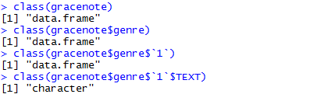
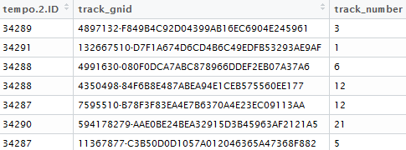
Data Cleaning: Gracenote
So unclean!
Read json as data frame using jsonlite
Eliminate nested data frames with flatten()
Drop a whole lot of useless columns

Slide 6
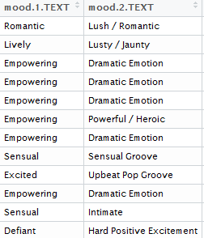
Merged Data: Issues and New Options
Which mood to use? More descriptive vs. fewer categories
Which genre to use? Which tempo to use? Which….
Unexpected columns:
‘artist_origin’
‘artist_type’ (male, female, group)
Difference in male artists’ songs vs. female?
Do certain countries produce artists of certain genres?

Slide 7
Word Research
Added z-scores to top 5000 songs(standard deviations from mean)
U.S, England, Europe, ROW different scoring systems
Got word count for top 5000
Average z-score for each word
Most popular for each word
https://github.com/MusicProject255/MusicResearch

Slide 8
Some Initial Visualizations...

Slide 9
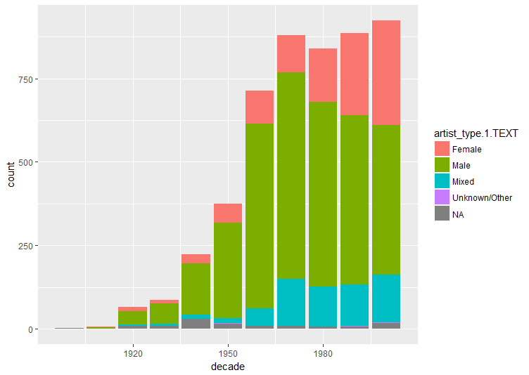
Artists through the years

Slide 10
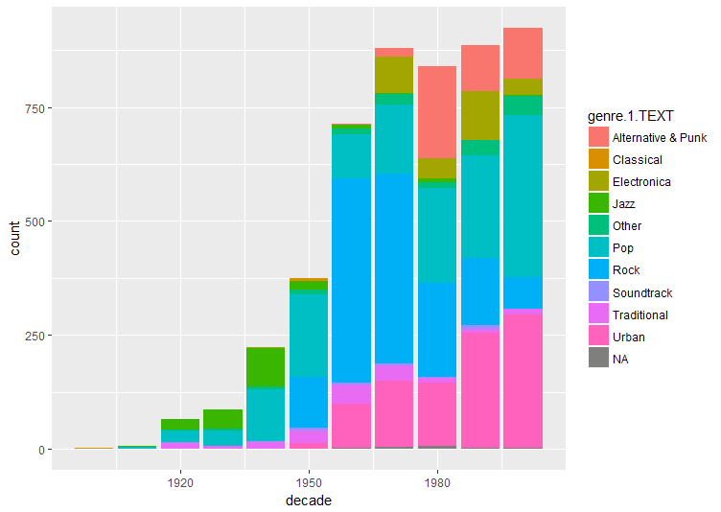
Genres through the years

Slide 11
Predictive models
Predicting score based on information given
Regression vs KNN
Testing our prediction model

Slide 12
What is KNN modeling
Nearest neighbor modeling
Compares “neighbors”
Averages the nearest K neighbors for new score
Current success

Slide 13
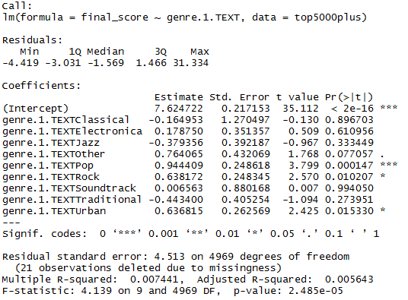
Goals
So many options…
  Word use vs. artist type
  Word use vs. year
  Effect of words on score at different times
Select a focus
Interactive plots
Can we predict score?

